Slide 1

Model Testing for Edge Computing Software
TESTWORKS
AI개발팀 강 응 찬
yeschan@testworks.co.kr
Copyright ⓒ TESTWORKS Artificial Intelligence Lab. All rights reserved.

Slide 2
Edge computing software 모델 테스팅
TESTWORKS
Dataset: ms-coco(10000장)
Confg: edge software
Layers < tiny-YOLOv3
Img_size : 256 X 256
Classes: 80
Max_batches = 80200
Anchor-box : 3

Slide 3
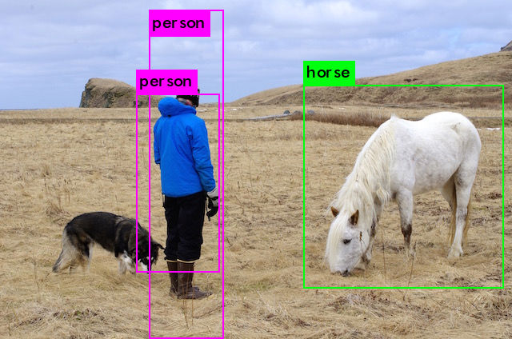
Edge computing software model testing 결과
TESTWORKS
horse: 73%
person: 100%
person: 88%

Slide 4
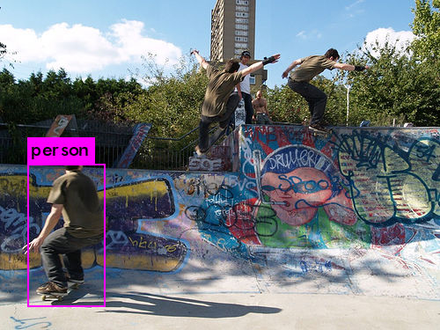
Edge computing software model testing 결과
TESTWORKS
Person: 81%

Slide 5
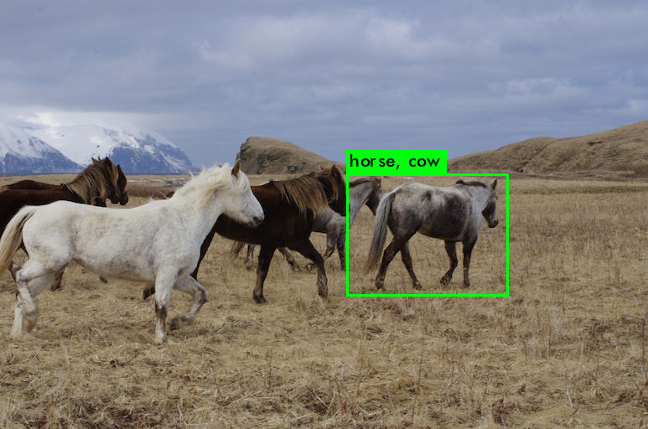
Edge computing software model testing 결과
TESTWORKS
horse: 85%
cow: 51%

Slide 6
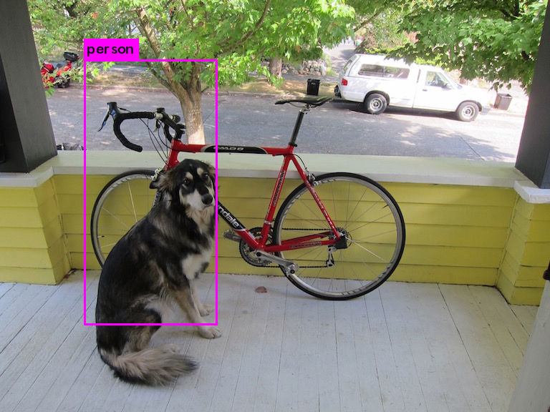
Edge computing software model testing 결과
TESTWORKS
person: 61%

Slide 7
Edge computing software model training 진행
TESTWORKS
10.14(목) Dataset(jpg, xml)
GTbox
Building labels
Train.txt
Valid.txt

